Slide 1

SalesforceDX: Purpose-Driven Source meets Source-Driven Purpose

Slide 2

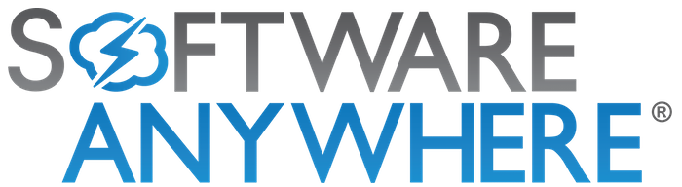







Thank you Sponsors!
A big shout out to our sponsors, without them these events would not be possible:
Notes:
Please spend a few seconds talking to the importance of sponsors.

Slide 3


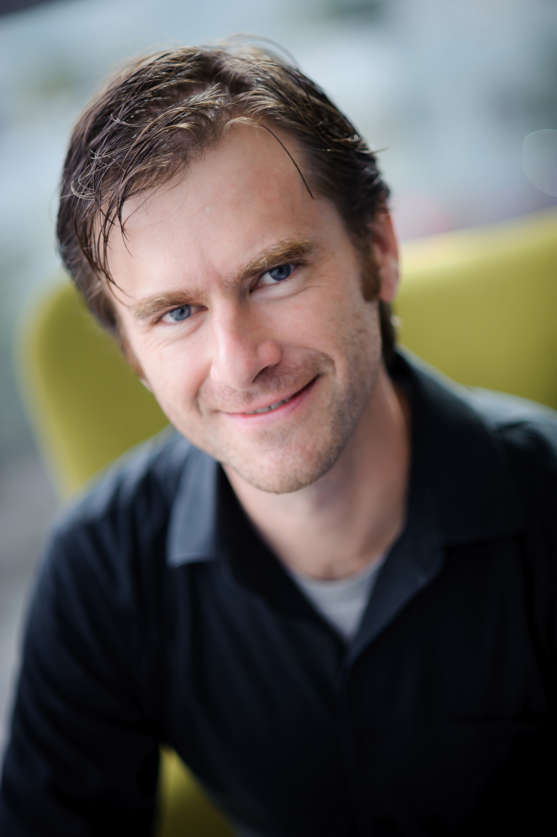



> whoami
Nate Pepper
Advanced Developer
CRM Science, Inc.
I am here because I love to hear myself type.
You can find me at:
@sforcebewithyou
Linkedin.com/in/sforcebewithyou
https://trailblazercommunitygroups.com/los-angeles-ca-developers-group/

Slide 4

https://trailblazercommunitygroups.com/los-angeles-ca-developers-group/

Slide 5

SalesforceDX
BELIEVE the hype

Slide 6
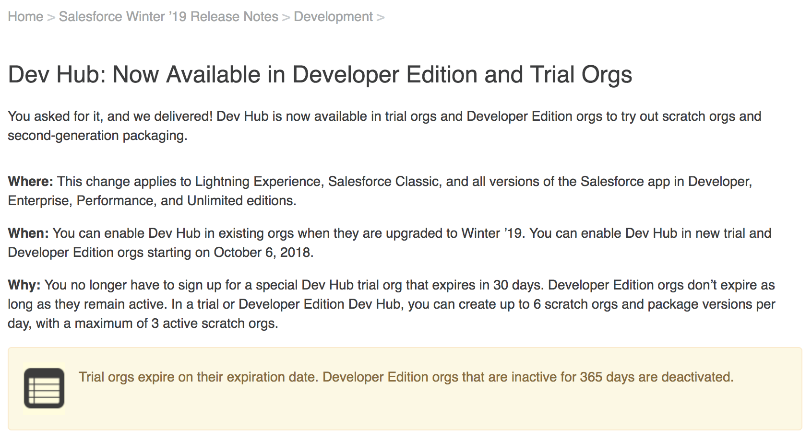
How do I get started?

Slide 7
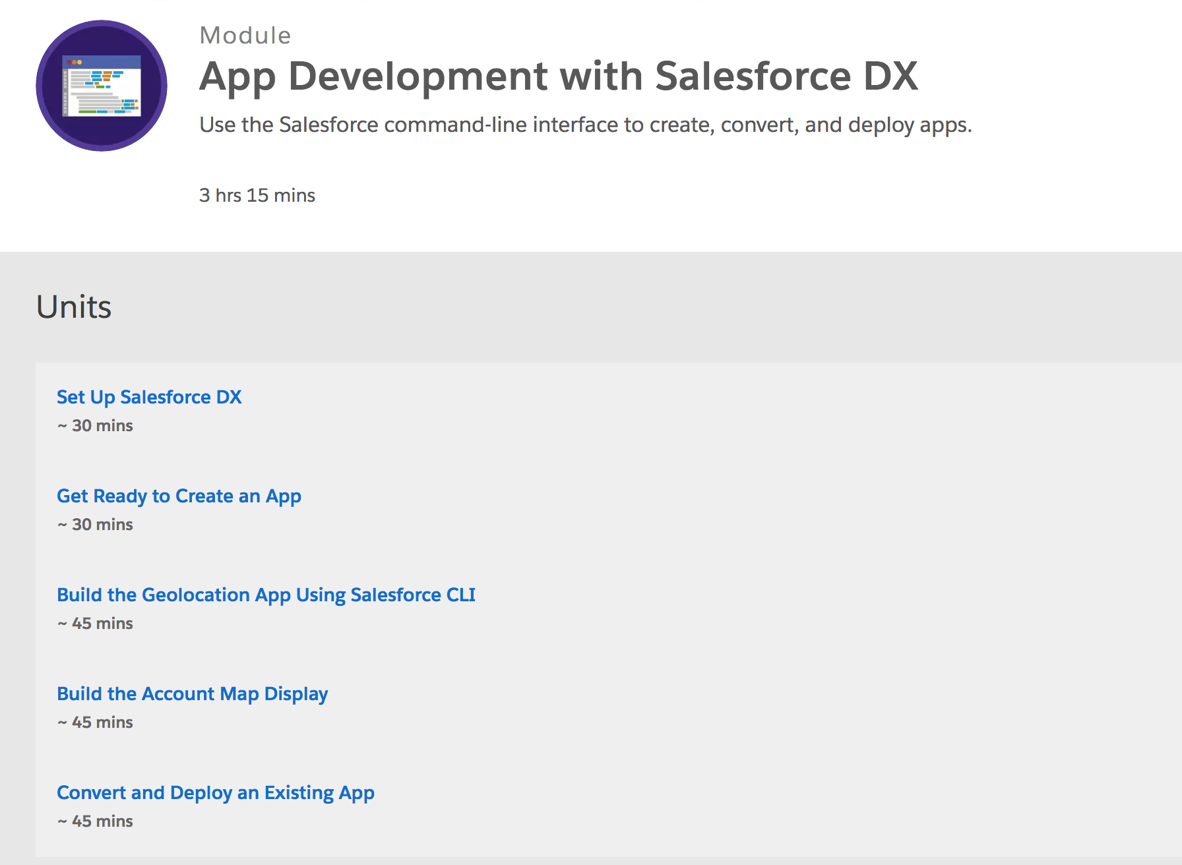
How do I get started?

Slide 8
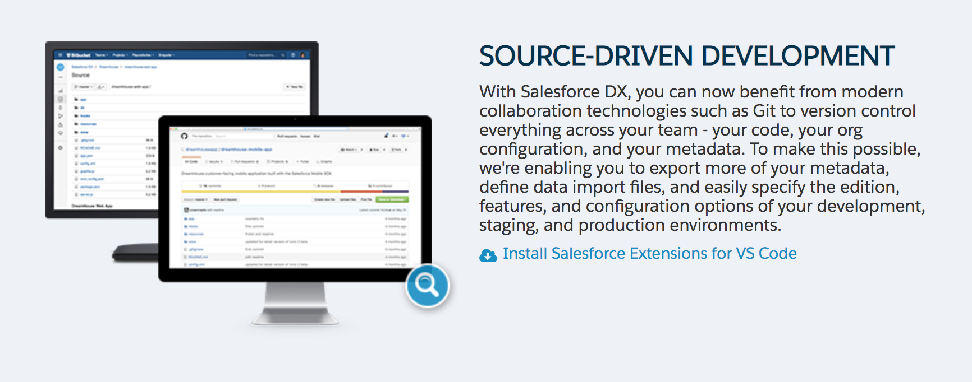
What is SalesforceDX?

Slide 9
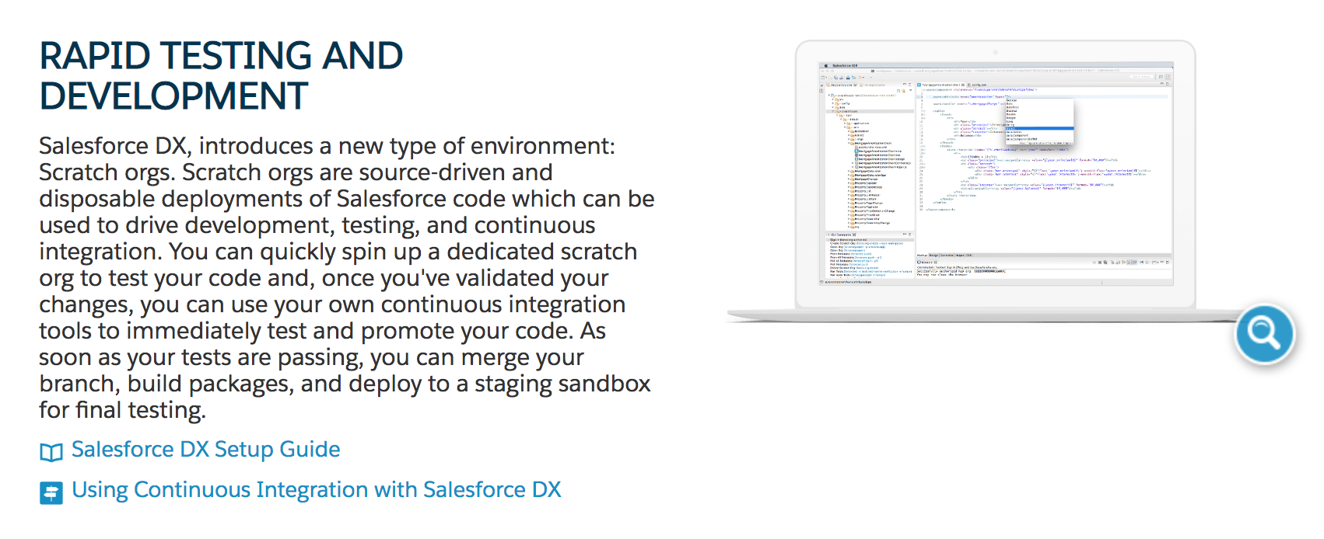
What is SalesforceDX?

Slide 10
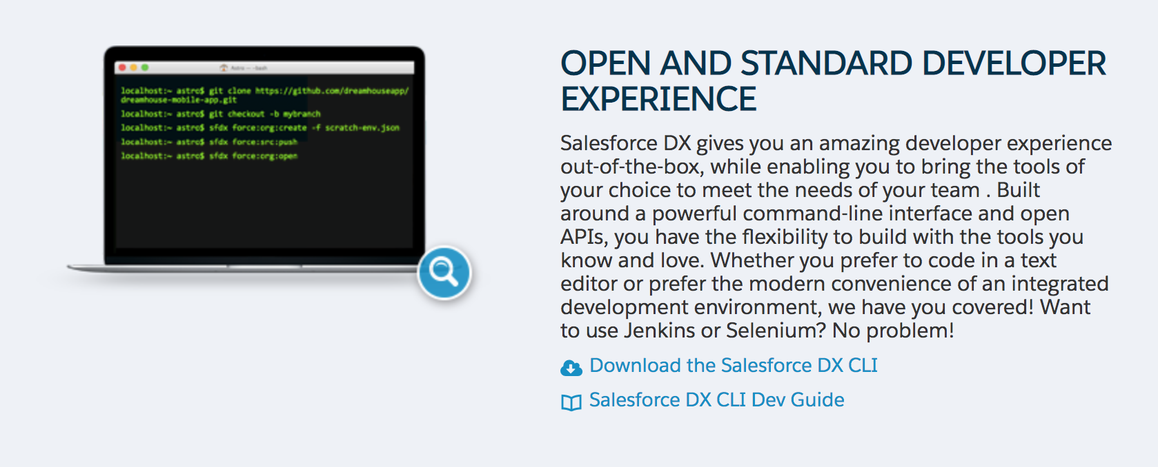
What is SalesforceDX?

Slide 11
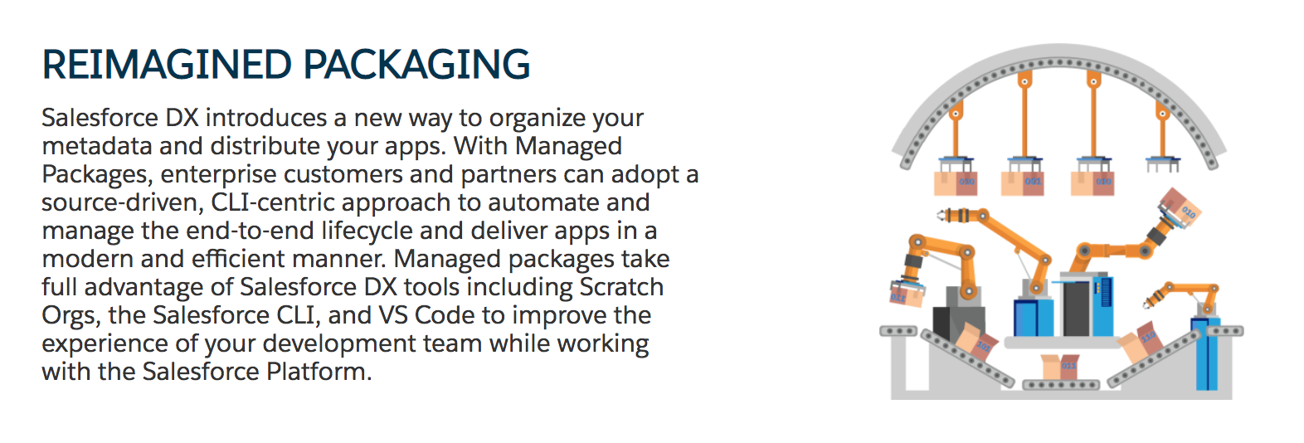
What is SalesforceDX?

Slide 12
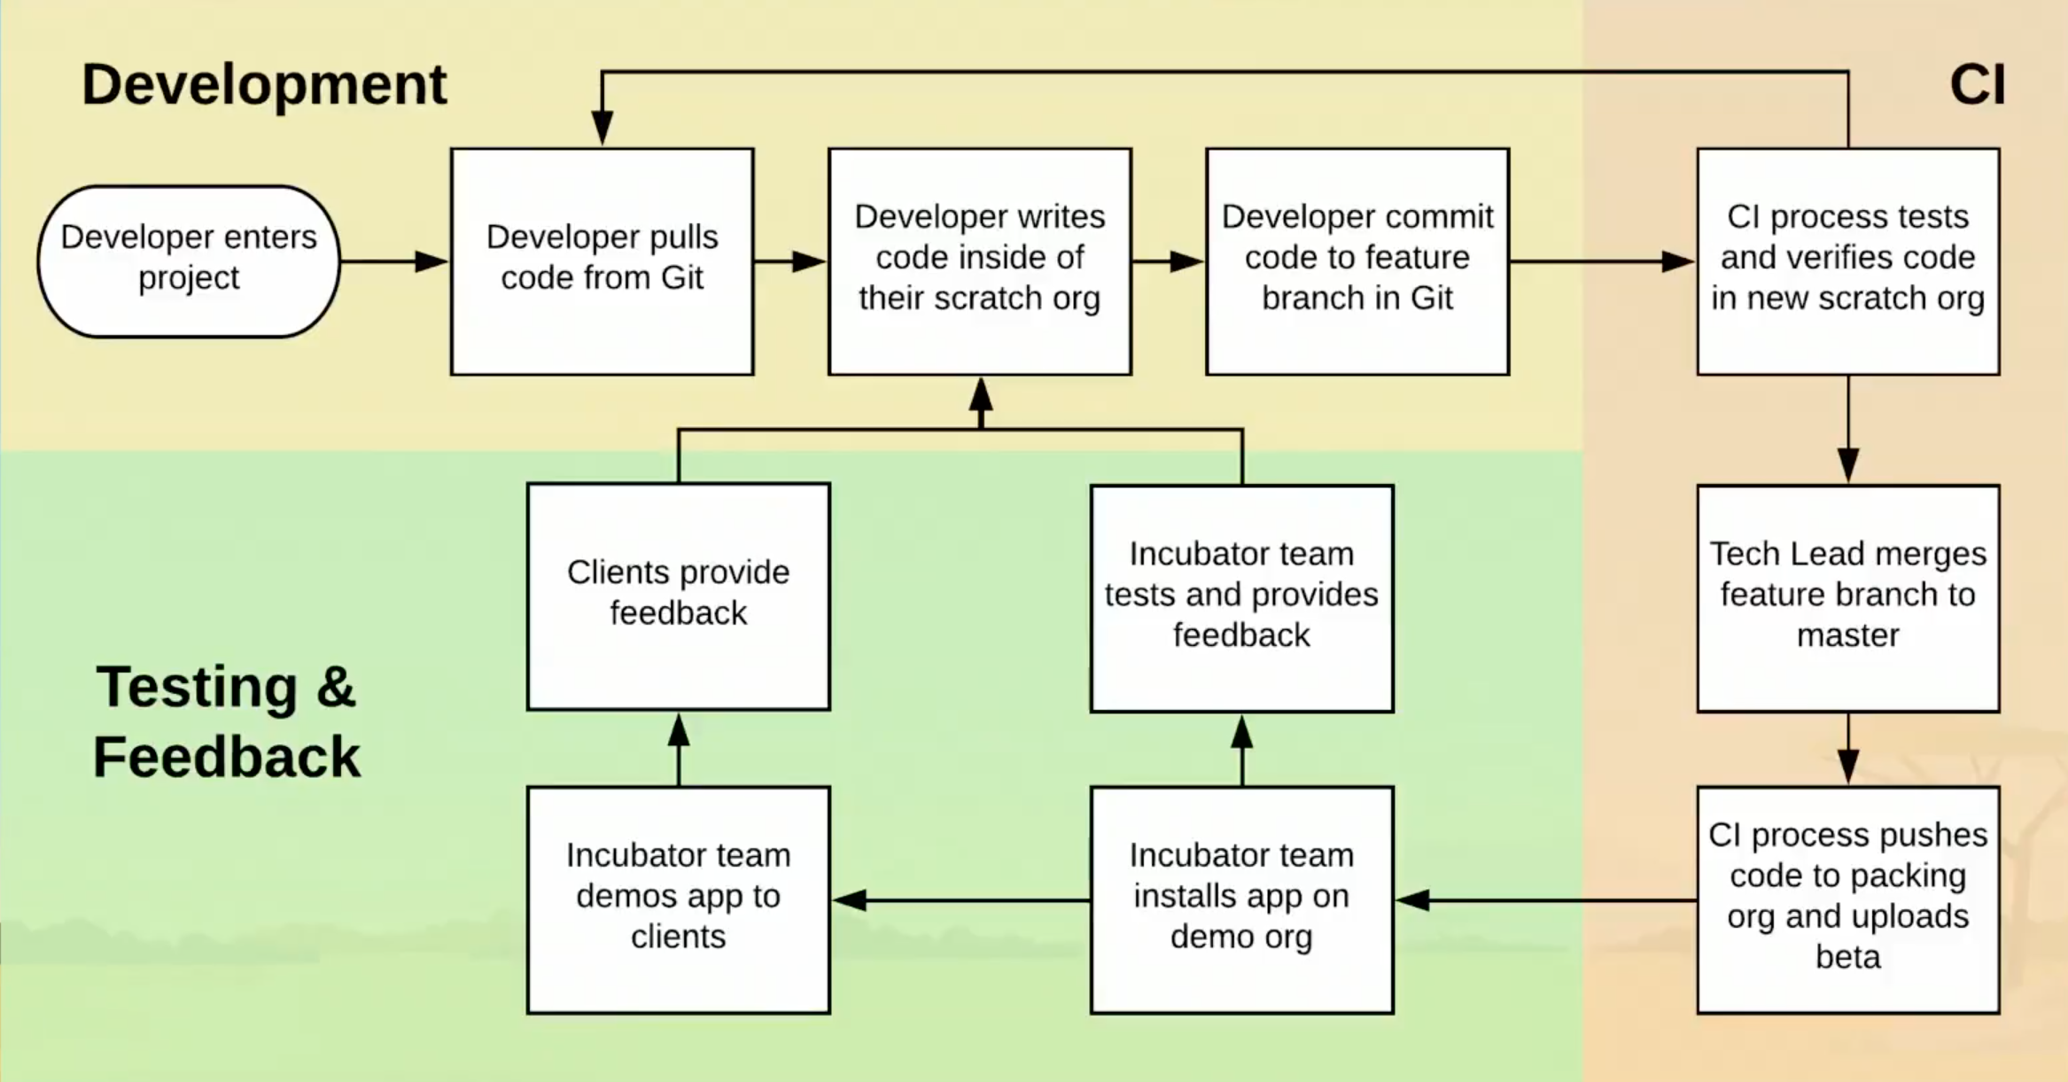

Slide 13

SalesforceDX Timeline
Pre-DF16: Remember the CLI built on Go?
Dreamforce 2016: First announced
June 2017: Open beta launches
October 2017: Generally Available

Slide 14
But what is SalesforceDX *REALLY*? ¯\_(ツ)_/¯

Slide 15


The Three Basic Components
Salesforce
Version Control
Local System

Slide 16
Version Control
Remote server (GitHub, BitBucket, rack in the basement, etc.
A decent branching strategy (don’t have one? Use git-flow! https://nvie.com/posts/a-successful-git-branching-model/ )
If you’re using packages AT ALL, a decent tagging strategy (see above, or at least tag your released versions on the commits that end up releasing)

Slide 17
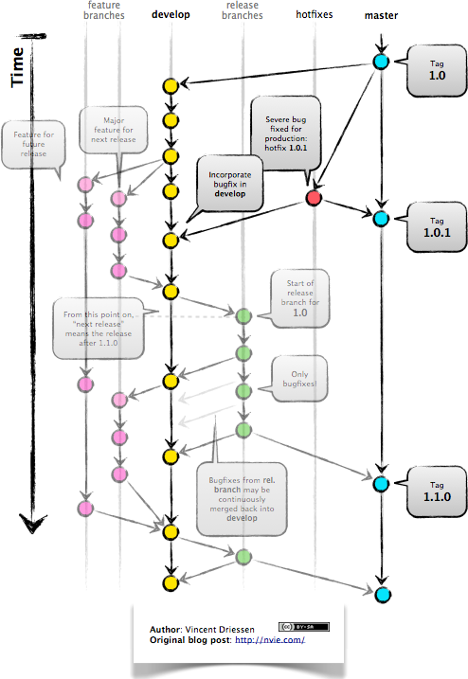
Whoa, backup… What is Version Control?
Advanced

Slide 18
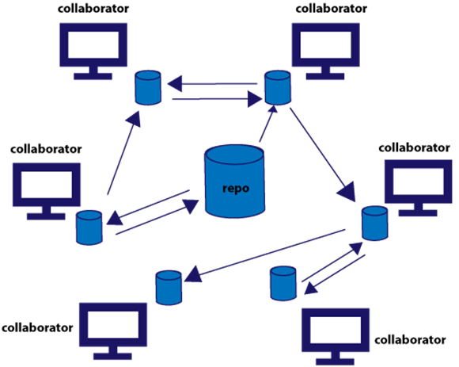
Whoa, backup… What is Version Control?
Intermediate

Slide 19
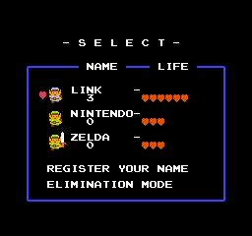
Whoa, backup… What is Version Control?
Beginner

Slide 20

“This is git. It tracks collaborative work on projects through a beautiful distributed graph theory tree model.” “Cool. How do we use it?” “No idea. Just memorize these shell commands and type them to sync up. If you get errors, save your work elsewhere, delete the project, and download a fresh copy.”

Slide 21

“This is git. It tracks collaborative work on projects through a beautiful distributed graph theory tree model.” “Cool. How do we use it?” “No idea. Just memorize these shell commands and type them to sync up. If you get errors, save your work elsewhere, delete the project, and download a fresh copy.”

Slide 22
What is git?
Written by Linus Torvalds (the Linux guy) in 2 weeks because he was P.O.’ed at available tools (no really, look… http://y2u.be/4XpnKHJAok8)

Slide 23
Local System
SalesforceDX CLI (download here: https://developer.salesforce.com/tools/sfdxcli
Some sort of version control system (not using one already? Use git: https://git-scm.com/
Those lovely text files of code! (Apex and *all* the XML)

Slide 24

ANDROID
Nope.
Place your screenshot here

Slide 25
iPHONE
Nope.
Place your screenshot here

Slide 26
TABLET
Maybe a Surface? But Surace Laptop, not Surface Pro
Assume “Nope.”
Place your screenshot here

Slide 27
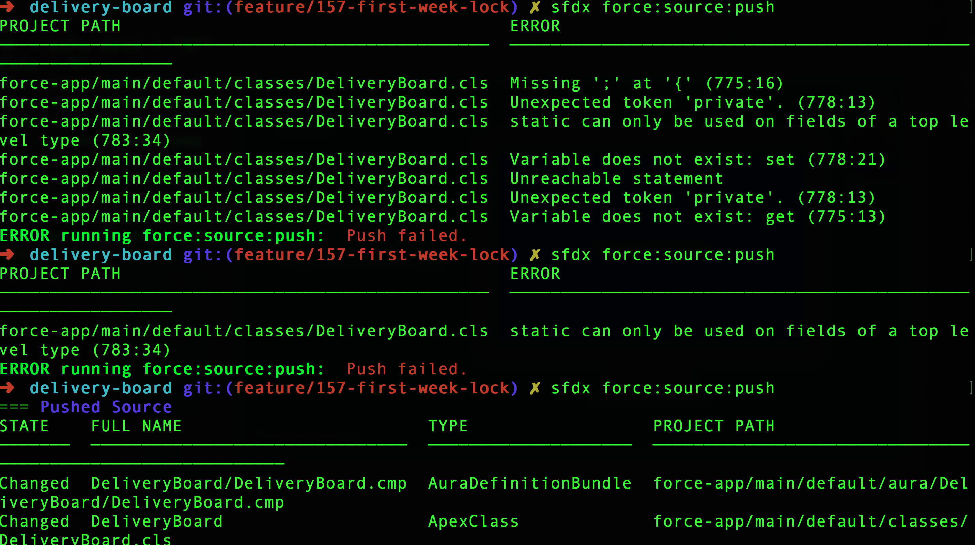
DESKTOP
YAS! (There are worse things than being tied to your desk or lap.)
Place your screenshot here

Slide 28
Salesforce Infrastructure
The orgs (prod, sandbox, developer, and yes… scratch)
Where the code lives
Cool behind the scenes stuff like brand new SObjects you’ll never directly interact with

Slide 29
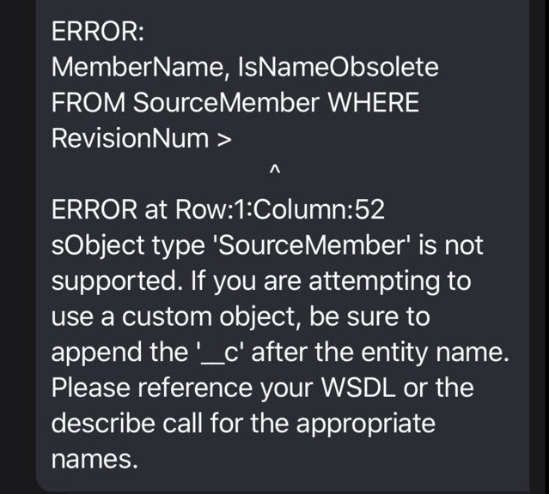
Salesforce Infrastructure
The orgs (prod, sandbox, developer, and yes… scratch)
Where the code lives
Cool behind the scenes stuff like brand new SObjects you’ll never directly interact with…
Except if you try to connect sfdx
to a Trailhead playground

Slide 30
DEMO!

Slide 31
Q&A

Slide 32
Q&A (not QA)

Slide 33
Thank you Sponsors!
A big shout out to our sponsors, without them these events would not be possible:
Notes:
Please spend a few seconds talking to the importance of sponsors.

Slide 34
Thank Y u!
Any questions?
You can find me at:
@sforcebewithyou
MayTheSForceBeWithYou@gmail.com
925.286.3499
https://www.linkedin.com/in/sforcebewithyou/

